Slide 1
An Overview of Recommendation Systems using Machine Learning Algorithms
GROUP MEMBERS:-
1814007: Bhavik Bhatt
1814008: Jainam Mehta
1814009: Sourabh Bujawade

Slide 2
Need for Recommendation Systems
Recommendation systems are becoming increasingly popular and an important aspect of several software systems from all kinds of domains.
Users cannot be expected to manually browse through different items to find what he is looking for.
Recommendations are made by taking into account unique properties of the users and hence different users or groups of users receive various recommendations.
Hence, the need for implementing the recommendation systems has been increasing widely for:
Studying the tastes and preferences of the customers
Increasing traffic in the website
Promoting products
Providing better User Experience
Boosting sales and profits

Slide 3
Literature Review
Paper Name | Study | Result
Machine Learning Based Recommendation System [1] | A new machine learning based recommendation system is suggested wherein to calculate similarity measure, weighted entropy which helps to determine the users with similar interests. The target user is required to fill in the ratings so as to recognize the closely related users from the knowledge base and top N recommendations are produced accordingly. | The proposed system which uses weighted entropy and opposite preferences as a similarity measure shows a significant amount of progress in accuracy as compared to the traditional recommendation system which uses the inter-user similarity to generate a set of recommendations that satisfies the target user.
Recommendation Systems with Machine Learning [2] | The paper presents different recommendation systems and compares them along with discussing the development of these models. The paper also deals with finding different ways of using machine learning models to create recommendation systems. With user, item and user-item interaction data as the basis, different machine learning algorithms used in the discussed systems are capable of making item suggestions. It provides a general solution for ranking prediction which is accurate. | One model was developed using a collaborative filtering-based recommendation with a novice open-source machine learning framework, ML.NET. The second model was built using Microsoft's Azure Machine Learning Studio, which allowed a completely different approach towards developing machine learning solutions. The result showed that the first approach had better RMSE however, it was the second approach that was able to solve the cold start problem.

Slide 4
Literature Review
Paper Name | Study | Result
A Machine Learning Based Implementation of Product and Service Recommendation Models [3] | This paper proposed two prototypes for recommendation models using machine learning. Following the prototype, two recommendation models were implemented which included banking services and a movie recommendation system. | These example prototype implementations of banking services and movie recommendation prove to be an excellent example depicting the use of machine learning algorithms for designing recommendation models. This is an initial step toward developing an efficient recommendation model that will operate with bigger data sets.
Movie Recommendation System Using Semi- Supervised Learning [4] | This paper presents a recommendation system for movies using different approaches in the Python programming paradigm. It takes the data set as input consisting of different movies released on or before July 2017 and provides recommendations based on different approaches. | The recommendation system has been implemented using different approaches: simple recommendation system, content-based filtering approach and collaborative-based filtering approach in order to solve the problem of searching through lots of results for finding the one that the user actually needs. The different approaches provided different recommendations according to the parameter used in these approaches.

Slide 5
Literature Review
Paper Name | Study | Result
Machine Learning Algorithms for Recommender System - a comparative Analysis [5] | These studies took various types of machine learning algorithms to their logical limits in order to reach the highest level of precision feasible, and they provided a thorough comparison. | The importance of all of these algorithms can be seen in the large increase in accuracy, as demonstrated by the experimental examination of the cold start problem.
Course Recommendation for students using Machine Learning [6] | This paper proposed a framework which recommends the discretionary courses to understudies based on their interest in a specific area. | Depending on the distribution of like understudies' course scores, client-based synergistic course proposal framework is intended to advise understudies on elective courses

Slide 6
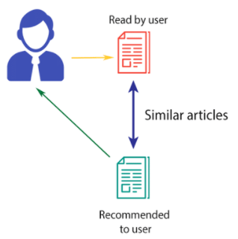
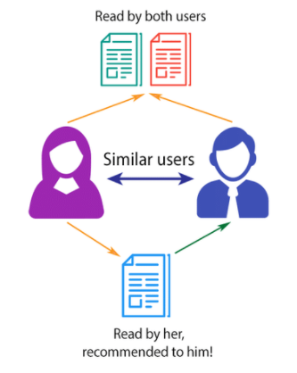
Machine Learning Algorithms
Content Based Filtering:
Uses the similarity between products to make suggestions and recommendations.
The advantages offered by this algorithm are:
Independence from users
Transparency
Collaborative Filtering:
Collaborative filtering is manifested by studying the behavior of a group of users to provide suggestions to other users within the same group.
The likings of one user influences the recommendation provided to the other user.

Slide 7
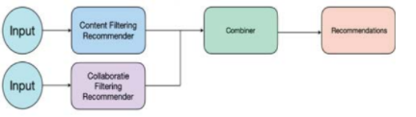
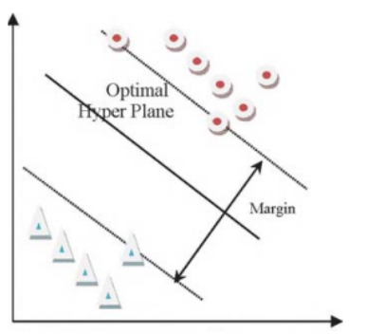
Machine Learning Algorithms
Hybrid Model:
Hybrid model is the combination of the content based filtering method and the collaborative filtering.
It is the simplest and the most direct way to build a recommendation system having features from both models.
Support Vector Machine Algorithm:
It is a supervised machine learning algorithm mainly used for classification and has proven to be very efficient in classifying unseen data.
Here, the data is classified into different classes with the help of an optimal hyper plane.

Slide 8
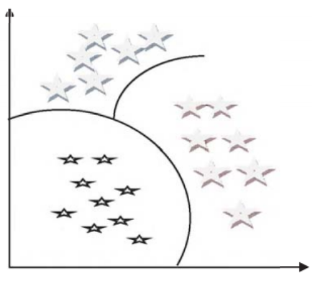
Machine Learning Algorithms
Naïve Bayesian Classifier :
It is based on bayes algorithm where there is a presence of one feature which is independent of other feature.
To obtain better results, it is recommend to use this classifier in combination with other algorithms.
K-means clustering :
It is a centroid-based clustering technique where the algorithm takes input and tries to segregate the whole input into k-number of clusters.
All items move towards centroid and centroid updates in each iteration. When no change in centroid then algorithm stops this result in reduced computational complexity.

Slide 9
Results and discussion
In the paper [5], 3 MovieLens datasets each of 10k, 50k, 100k rows used which varies in sparsity in order to compare their accuracy.
Precision measurements are used to show the analysis of these algorithms.
Author transformed 30% of the user's viewed movies into unseen movies for each test user and use the algorithms mentioned above.
The right suggestions are those that are also present in the converted movies out of the total number of recommendations (T).
Precision = (𝛴tc / 𝛴T ) * 100
Algorithm/Size | 10K | 50K | 100K
Content Based | 18.45 | 18.66 | 19.10
Collaborative | 17.97 | 18.69 | 19.95
Hybrid | 20.31 | 21.03 | 22.20
K-Mean | 21.05 | 21.93 | 22.67
Naive Bayes | 24.62 | 25.19 | 25.73

Slide 10
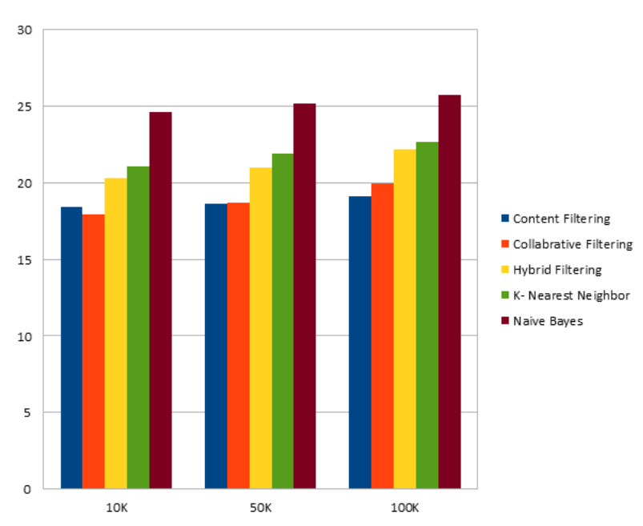
Results and discussion Contd.
The figure below shows the graphical comparison of the experimental values.

Slide 11
Conclusion
In this paper we have given a brief about various machine learning algorithms which can be applicable for recommendation systems.
This paper helps to identify the best machine learning algorithm suitable for recommendation systems.
We have concluded and presented findings in a tabular summary which can help visualize comparison between different algorithms with respect to their precision rates.
Based on the study and results from our survey we can conclude that most recommendation systems should be based on Naive Bayes algorithm due to its precision and accuracy.

Slide 12
Movie Recommendation System

Slide 13
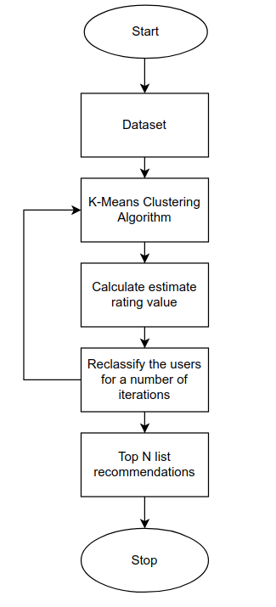
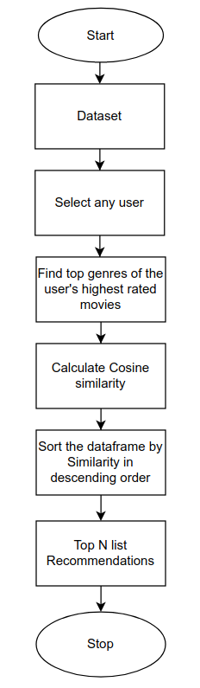
Model
K-Means
Content
Based

Slide 14
Tools and Libraries
Programming Language:
Python
Libraries:
pandas
numpy
matplotlib
sklearn
scipy
Algorithms:
K-Means
Content Based

Slide 15
Dataset
Dataset Name:
MovieLens
Description:
The dataset used is MovieLens dataset which consist of 668 unique users, 10325 Movies and 20 genres.
Dataset Link:
https://www.kaggle.com/ayushimishra2809/movielens-dataset

Slide 16
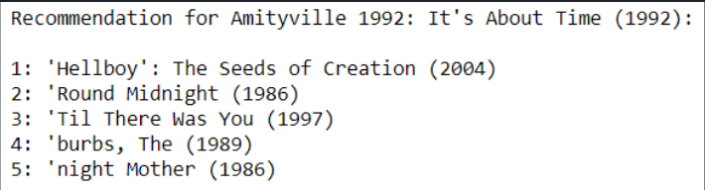
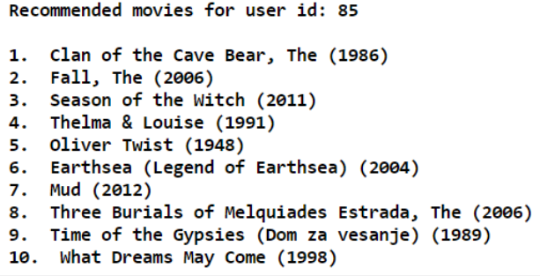
Results
K-Means
Content Based

Slide 17
Conclusion
We successfully implemented a machine learning model for movie recommendation system using collaborative filtering and content based filtering.
We have used K means for implementing collaborative filtering and content based filtering using cosine similarity on genres of user’s highest rated movies.
We were successfully able to recommend movies with genres similar to the user’s highest rated movies in content based filtering and similar movies in collaborative filtering using K-means.

Slide 18
Github Link
https://github.com/Jainam321/Movie-Recommendation

Slide 19
References
Fanca, A. Puscasiu, D. Gota and H. Valean, “Recommendation Systems with Machine Learning” 21th International Carpathian Control Conference (ICCC), 2020.
S. Ganguli and Dr. S Thakur, “Machine Learning Based Recommendation System” 10th International Conference on Cloud Computing, Data Science & Engineering (Confluence), 2020.
S. Cherukullapurath Mana and T. Sasipraba, “A Machine Learning Based Implementation of Product and Service Recommendation Models” 7th International Conference on Electrical Energy Systems (ICEES), 2021.
S. Roy, M. Sharma and S.K. Singh, “Movie Recommendation System Using Semi-supervised Learning” Global Conference for Advancement in Technology (GCAT), 2019.
S.P. Sahu, A. Nautiyal, M. Prasad, “Machine Learning Algorithms for Recommender System - a comparative analysis” International Journal of Computer Applications Technology and Research (IJCATR), 2017.
L Paul Jasmine Rani, Dr. D.C. Joy Winnie Wise, KV. Ajayram, T. Gokul, B. Kirubakaran, “Course Recommendation for students using Machine Learning” International Conference on Electronics and Sustainable Communication Systems (ICEES), 2020.

Slide 20
Thank You

